Slide 1
Individual Meeting
Jason Chang

Slide 2
UCLA VGR
I’ve received the DS-2019 and the final approval of VRG
J-1 visa interview: 2026/01/21 (I’ve filed an emergency request for earlier interview)
Final date for UCLA VGR: 2025/02/10~2026/02/09
Chinese New Year: 2025/01/27~2025/02/02
Leaving Taiwan on 2025/02/02
TSMC resignation on 2025/01/24
TSMC consultant
When should I ask Wei Wang about this? 2 days per week for the workload?
In TSMC, when should I start working about the contract? (Dr. Chen is ok with me being the consultant)

Slide 3
NeurIPS 2024
Key words (for me): LLM agents, multimodal, mixture of experts, mamba, reinforcement finetuning
Speakers like Fei-Fei Li are very inspiring
> 200 booths
Chinese drama
So many Koreans (especially in time series)
Time series papers
Main track (met Prof. Wei Wang)
Retrieval-Augmented
Time series generation
Time series with news (using LLM for reasoning)
Workshop (met Dr. Qingsong Wen)
Demand forecasting (TimesFM is the best)
Distribution shifts
Time series reasoning
Waymo dataset for motion forecasting (add Lidar dataset)
Time-MoE and Time-300B (ICLR 2025)
Taiwan night

Slide 4
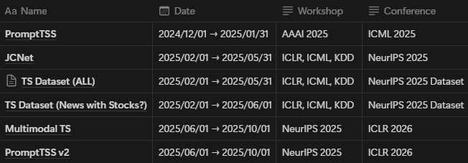
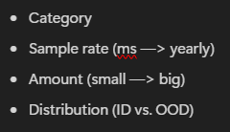
After NeurIPS 2024
A small talk at TSMC (when? 1/2? Although I work from Kaoshiung that week)
Share what I’ve learnt
Pave a way for the consultant in the future
Roadmap for the papers (first author)

Slide 5
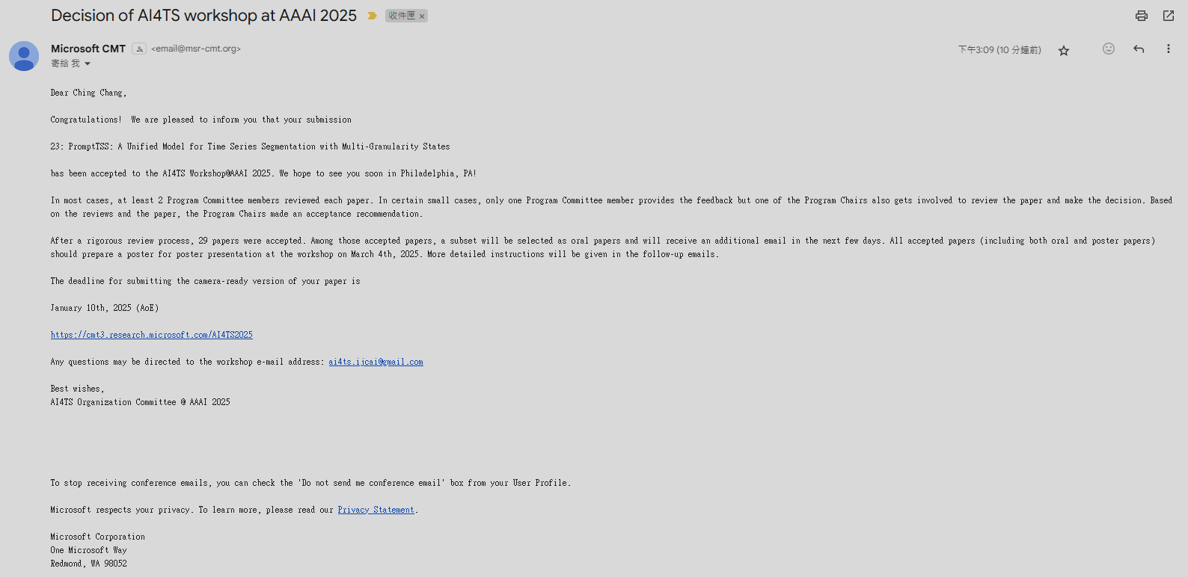

Slide 6
AAAI 2025
I’m the reviewer of AAAI 2025 AI4TS workshop
I also submit PromptTSS (short paper format) to this workshop (accepted just now)
Should I attend this conference?
It’s in the U.S., so it’s pretty close from LAX to PHL (flight fee around NT$5,000)
Should I register? Is there any compensation from the lab?

Slide 7
Thanks for your attention

